Slide 1
Intro to Natural Language Processing for Clinical Text
Matthew Engelhard

Slide 2
Today: NLP and Model Interpretability
What can natural language processing (NLP) do in clinical medicine, and what is the role for predictive versus generative approaches?
How does current NLP (i.e., large language models) work?
Foundations: count-based models
Foundations: word vectors
Modern LLM architectures (encoder, decoder, encoder-decoder)

Slide 3
Predictive models for tabular data
y, associated value or label
x, data/features for a subject or patient
End goal: predict y from x
Notes:
Let’s take a moment to review what we discussed last time
Opportunity to answer questions, which we didn’t have before
We talked about the basics of a predictive model.
It takes a set of data, or features, x, and applies a mathematical function or logic to make a prediction about an associated value, y
The thing that takes x and returns the prediction about y – that’s the model, the ”machine” in machine learning.

Slide 4
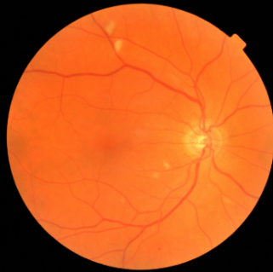
CNNs: predictive models for image data
y, referrable diabetic retinopathy
x, retinal image
End goal: predict y from x
Notes:
It’s just another predictive model.
But, we need a much more complex model to due to the complex, spatial structure of these data
Extract a hierarchy of increasingly complex features

Slide 5
NLP: predictive models for text data
y, abnormality present
x, radiology report
End goal: predict y from x
Notes:
Today, we’re going to consider a new kind of predictive model, one in which the input to the model is a text document, and the output is a label associated with that document
For example, the input might be a radiology report, and the output might be a binary label indicating whether an abnormal finding was noted in the report
But as we know, all our predictive models – logistic regression, MLP, CNN – they all work with numbers
So, right from the start we’re faced with a difficult problem – how can we convert a document into a feature vector that encodes its contents?
If we can do that, we can then apply any of the classification models we’ve previously discussed
So, that’s the problem we’ll be solving today.

Slide 6
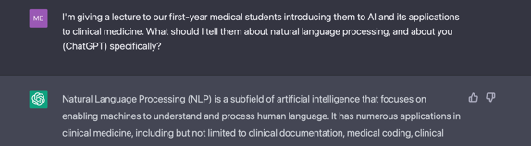
Generative or predictive?
y, next word
x, conversation history
End goal: predict y from x
Notes:
Now, what about the systems we’re seeing today?
Does the paradigm I’ve described still fit?

Slide 7
What can today’s NLP do?
And what is the emerging role of generative versus predictive approaches?
Notes:
Stimulate discussion here

Slide 8
Clinical notes and other text contain key info not found elsewhere.
Notes:
Structured only: EHR-S
Unstructured: EHR-U
Big finding: better recall/sensitivity with notes
----- details -----
Here’s the key finding of a recent JAMIA paper focused on identifying cardiovascular diseases and procedures from EHR data
Each of these concepts was identified by chart review by clinical expert annotators
And then they train models to identify those concepts based on
(a) structured data – this is “EHR-S”
And (b) clinical notes – this is “EHR-U”
Their findings tell a consistent and compelling story
Both approaches do pretty well in terms of precision – also known as positive predictive value – in other words, both models are usually right when they tell you they’ve identified one of these concepts
However, the recall – aka the sensitivity – is FAR better for the unstructured models
Very often, the structured data models miss it
And if you look through the details, they do a good job building these models
The issue is not the models themselves – it’s that the structured data very often doesn’t contain the relevant information. It’s only found in the notes.

Slide 9
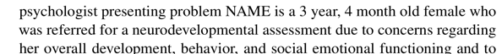
Predictive models remain highly relevant.
y, autism risk
x, clinical note
End goal: predict y from x

Slide 10

Case Study: SMS Triage for Global Maternal Health
Maternal Health HelpDesk:
2 million women connected to NDoH staff via SMS
https://www.praekelt.org
Binary Classification: Urgent Message? (Yes/No)

Slide 11
Often predictive and generative models are complementary.
Maternal health response system:
Speech to text (predictive)
Translation (predictive)
Identification of key concepts and topics (predictive)
Triage (predictive)
Generation of template and/or complete responses in specific cases (generative)
It is much easier to evaluate the performance of predictive models, and in turn to know when and how much to trust them.

Slide 12
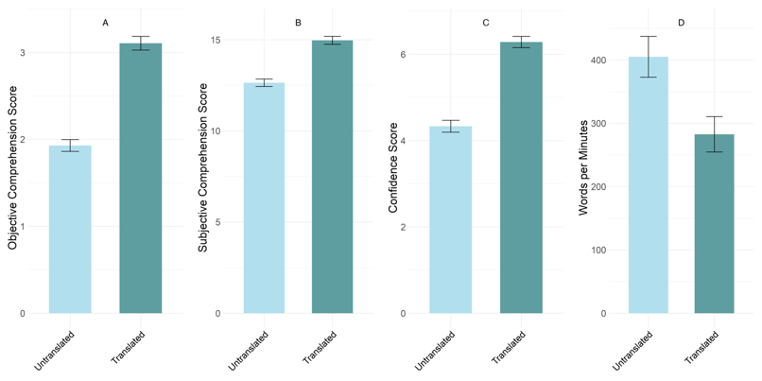


In some cases, however, generative models have superseded predictive models.
“Translation” of discharge notes into plain language using GPT4 substantially improves patients’ ability to comprehend them.
Anivarya Kumar
Isabella Wang
Notes:
Do we treat this as a translation (i.e., sequence to sequence) problem? Or a text generation problem?

Slide 13


Extracting specific info from documents: predictive or generative?
Data needed to determine scheduling needs
ICD-10
Stage
Age
Date of Dx
Hormone Receptors and molecular biomarkers
History of Treatment (med, surg, rad)
Undiagnosed patients only: Review of symptoms
While a predictive approach might be more trustworthy in principle, generative models can perform many tasks “zero-shot”, i.e. without task-specific training.
DIHI ‘24, led by Emily Norboge

Slide 14
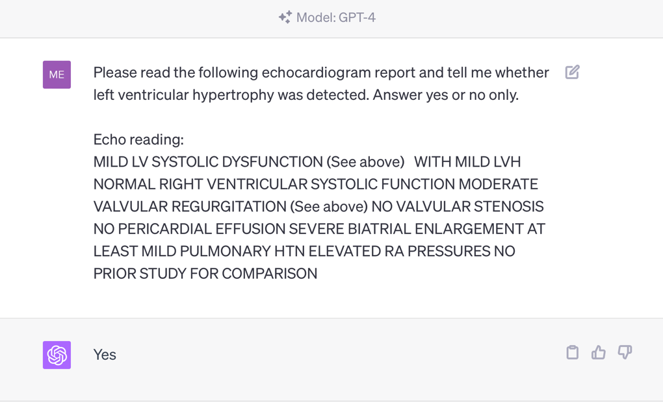
Are all tasks special cases of text generation?

Slide 15
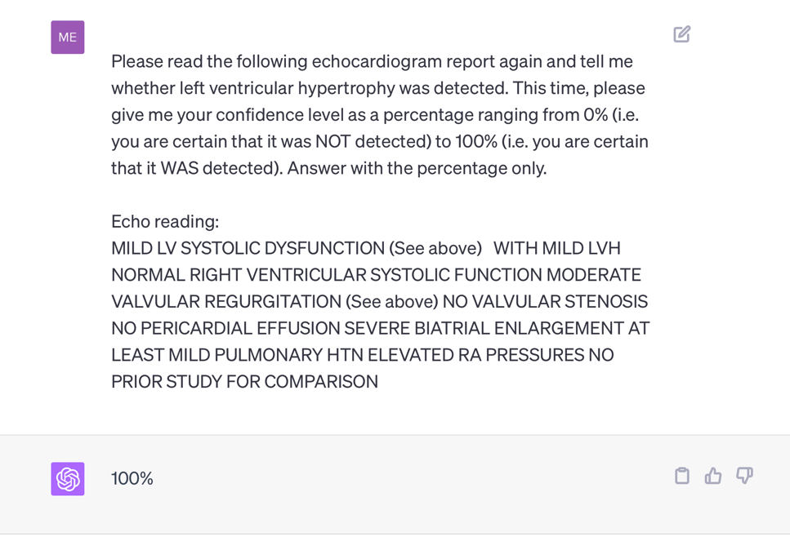
Are all tasks special cases of text generation?

Slide 16
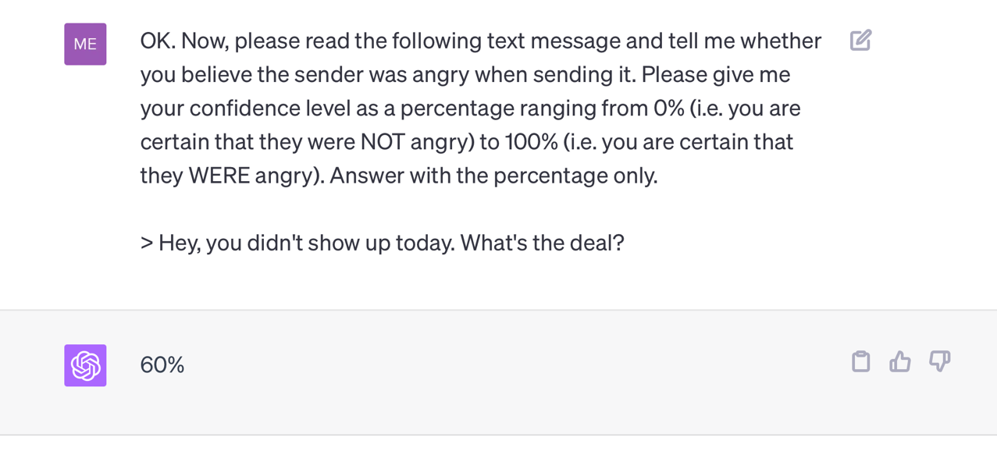
Are all tasks special cases of text generation?

Slide 17
Current directions: RAG vs long context
Suppose we wish to answer questions or extract information from a large collection of documents (e.g., all clinical notes for a given patient)
How do we use an LLM to do this?
Option 1: very long context window
Option 2: retrieval augmented generation (RAG)
Currently, RAG is commonly used because it is effective and scalable, and it (partly) addresses LLM pitfalls, including hallucinations.

Slide 18
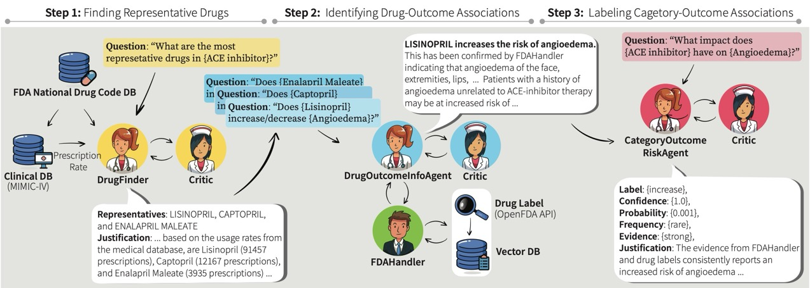
Current directions: agentic AI
Multi-LLM-agent systems including:
An orchestrator agent
Task-specific agents (e.g. DocChat, SQLchat
Critic agents
Choi, Palumbo, et al.; submitted to Machine Learning for Healthcare

Slide 19
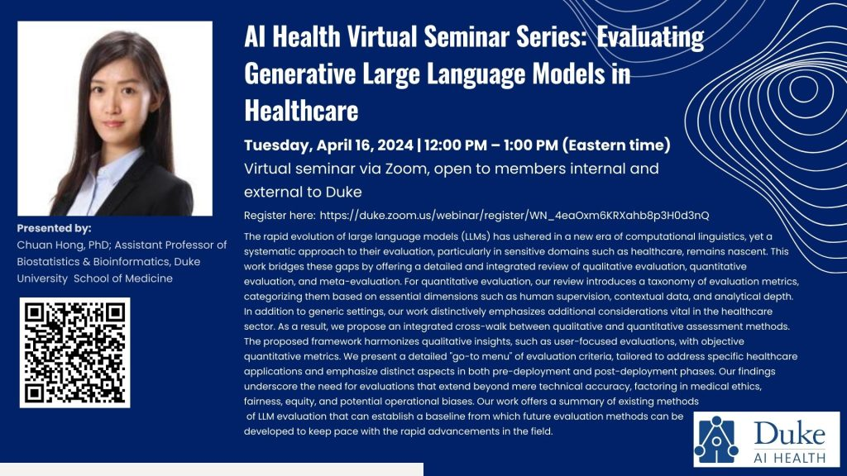
Current directions: evaluation of generative models
Open questions include:
Can we trust models to evaluate other models?
How can models learn when to defer to human experts?
How can we identify LLM biases? (more on this in PIONEER sessions)
Notes:
Ask the group – how would you evaluate a generative model?
What approaches have you seen?

Slide 20
How does NLP work?
Key problem: how do we make predictions from text?
Notes:
Old but important

Slide 21
A Simple Predictive Model: ICU Mortality
???
WBC Count
Respiratory Rate
Creatinine
Mean BP
Hematocrit
Age
Temperature
Pulse Rate
Survival
End goal: predict odds of hospital mortality
Notes:
What goes in these boxes?

Slide 22
Training Set (Historical Data)
x₁
y₁
Find an equation that predicts $y$ based on $x$ across the training set
x₂
y₂
x₃
y₃
x₄
y₄
…
…
x_{N-1}
y_{N-1}
x_{N}
y_{N}
Notes:
How do we do that?
Gather a bunch of historical data
Want to find an equation that predicts y well based on x across that historical data
So we take all this data, we use it to find the parameters that are most consistent with the patterns of x and y that are present

Slide 23
Making Predictions for New $x$
x₁
y₁
x₂
y₂
Find an equation that predicts $y$ based on $x$ across the training set
<- Learn to predict new $y$
x₃
y₃
x₄
y₄
…
…
x_{N-1}
y_{N-1}
x_{N}
y_{N}
x_{N+1}
y_{N+1}
Notes:
Having done that, we have a trained model.
Now, when we see a NEW value of x, we simply plug it into our “learned” equation, and it tells us what we expect y to be. This is prediction.

Slide 24
Case Study: SMS Triage for Global Maternal Health
https://www.praekelt.org
Can we use a standard predictive model
setup to solve this problem?

Slide 25
This time, our training data is text
x₁
What helps with morning sickness?
How many months should I breastfeed?
I passed out and Mom said I was shaking
Where is the nearest clinic?
I am having heavy bleeding, what should I do?
What foods should I eat while pregnant?
My heart is racing and I can’t catch my breath
y₁
x₂
y₂
x₃
y₃
$yi$: Urgent or
Not Urgent?
<- Learn to predict new $y$
x₄
y₄
…
…
x_{N-1}
y_{N-1}
x_{N}
y_{N}
x_{N+1}
y_{N+1}
Notes:
Having done that, we have a trained model. Our parameters are learned – we hold them fixed.
Now, when we see a NEW value of x, we simply plug it into our “learned” equation, and it tells us what we expect y to be. This is prediction.

Slide 26
We need numbers, not words
Can we convert our text to a vector or sequence of numbers?
If yes, we can use logistic regression (or any other predictive model)!

Slide 27
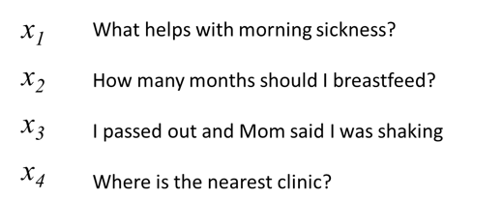
First try: count words in each SMS Step 1: Define a vocabulary of words
shaking
what
clinic
how
helps
was
nearest
many
with
said
months
the
morning
mom
should
sickness
and
I
is
how
out
breastfeed
passed
where
list of all words
(in no particular order)

Slide 28
Step 2: count how many times each vocabulary word appears in a given SMS
shaking
what
clinic
how
helps
was
nearest
many
with
said
months
the
morning
mom
should
sickness
and
I
is
how
out
breastfeed
passed
where
What helps with morning sickness?
x₁
0 | 1 | 0 | 0 | 1 | 0 | 0 | 0 | 1 | 0 | 0 | 0 | 1 | 0 | 0 | 1 | 0 | 0 | 0 | 0 | 0 | 0 | 0 | 0

Slide 29
Step 2: count how many times each vocabulary word appears in a given SMS
shaking
what
clinic
how
helps
was
nearest
many
with
said
months
the
morning
mom
should
sickness
and
I
is
how
out
breastfeed
passed
where
I passed out and Mom said I was shaking
x₃
1 | 0 | 0 | 0 | 0 | 1 | 0 | 0 | 0 | 1 | 0 | 0 | 0 | 1 | 0 | 0 | 0 | 2 | 0 | 0 | 1 | 0 | 1 | 0

Slide 30
Note that word order does not matter!
shaking
what
clinic
how
helps
was
nearest
many
with
said
months
the
morning
mom
should
sickness
and
I
is
how
out
breastfeed
passed
where
clinic is where nearest the
x₄
0 | 0 | 1 | 0 | 0 | 0 | 1 | 0 | 0 | 0 | 0 | 1 | 0 | 0 | 0 | 0 | 0 | 0 | 1 | 0 | 0 | 0 | 0 | 1

Slide 31

A “bag of words”
clinic
nearest
where
the
is

Slide 32
Now we can use logistic regression.
$$URGENCY LOG ODDS=β0+β1x1+β2x2+…$$
LOG ODDS
𝜎
y
shaking
clinic
morning
mom
sickness
breastfeed
passed
where
$$β1 β8$$
y, associated label:
(0 = not urgent, 1 = urgent)
x₁ | x₂ | x₃ | x₄ | x₅ | x₆ | x₇ | x₈

Slide 33
Count-based feature extraction is still useful!
Entirely data-driven
Vocabulary of words we care about is derived from the training data
We then represent text as counts of each vocabulary word
We can also count 2- and 3-word phrases; this helps with negation and context
Knowledge-driven extraction of key words or concepts
Rather than creating a vocabulary from the data, we can identify words we (or content experts) believe are important for a given task
Concept extraction systems (e.g. cTakes) will identify many alternative phrasings for the same clinical concept (e.g. diagnosis) and group them together as a single feature

Slide 34
Strengths and Weaknesses
(+) Count-based approaches are simple and work surprisingly well in practice
(+) Often the best approach with small datasets
(-) Does not capture word order
(-) Does not group synonyms together or understand semantic relationships between words

Slide 35
How does current NLP work?
Key problem: understanding nuances of meaning and context
Notes:
Old but important

Slide 36
Word vectors: a numeric representation of words that encodes their meaning
miserable
upset
joyful
melancholy
happy
content
euphoric
sad
unhappy
satisfied
merry
ecstatic
sorrowful
depressed
down
gleeful
<- sadder
happier ->
Numeric value indicating whether the word is happy or sad

Slide 37
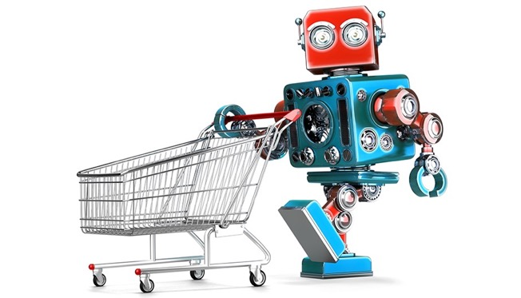
Grocery List
Training a robot to buy groceries
granulated sugar
vanilla extract
dark brown sugar
carrots
table salt
eggs
Example from Anand Chowdhury, MMCi 2019
Notes:
The robot doesn’t know all this stuff – too many grocery items!

Slide 38
Identify items by their attributes (including previously unseen items)
Dimension | 1 | 10
State | Liquid | Solid
Sweetness | Bland | Sweet
Color | Light | Dark
Size | Small | Large
Carrotness | Not really | Platonic essence of carrot

Slide 39
Why does this help us?
The model can make sense of words it hasn’t seen before (weren’t used in training)
Similar words (e.g. synonyms) will have similar attributes, and therefore will have similar effect on model predictions
(more complicated) Now we can convert text to a sequence of vectors; and we were already very good at making predictions from sequences of vectors

Slide 40
How do we learn these attributes? -> In brief, for now, but there’s an additional, optional lecture on this
KEY IDEA: words are defined by the context in which they appear
A man strolls down the street
A woman strolls down the street
A child strolls down the street
A crocodile strolls down the street
A banana strolls down the street
A concept strolls down the street

Slide 41
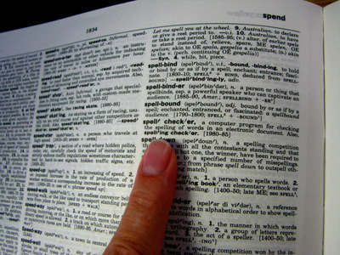
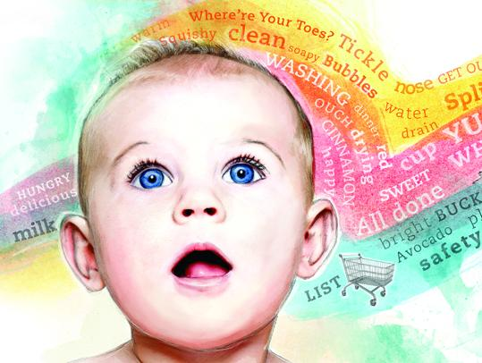
How do we learn these attributes?
KEY IDEA: words are defined by the context in which they appear
-> if words are always exchangeable, they must have very similar meaning
https://www.parenting.com/activities/baby/teach-baby-to-talk/
learn word meaning like an adult:
explicit definitions
learn word meaning like an child:
implicit definitions from context
Notes:
Like a (my) child: have the TV teach them!

Slide 42
What happens when we embed all words in a sentence?
Look up words individually to obtain their vectors
Construct a sequence of vectors
This is a sentence
x_{i}

Slide 43
What happens when we embed all words in a sentence?
Look up words individually to obtain their vectors
Construct a sequence of vectors
This is a sentence
Now we have a grid of numbers
Similar in many ways to an image
x_{i}

Slide 44
Now we can use deep learning…
…to learn to extract increasingly complex aspects of meaning

Slide 45

Now we can use deep learning to build our hierarchy of features.
low-level motifs
high-level motifs
dog
edges
shapes
textures
eyes
ears
paws
label
pixels
End goal: predict dog from pixels

Slide 46
Now we can use deep learning to build our hierarchy of semantic features.
low-level motifs
high-level motifs
PE
words
short phrases
concepts
topics
label
grid of semantic attributes
End goal: predict pulmonary embolism from text
Notes:
Much like in deep learning, low-level semantic features are often shared across domains/tasks, but higher level features are more task specific. So again, we can reuse models trained in different domains.

Slide 47
Recall: in image processing, we start with a pre-trained encoder
retinopathy
label
A CNN image encoder that converts the raw image to a vector of high-level motifs / features.
A final layer, or prediction head – this is a logistic regression model – that makes predictions about the label from these high-level features.
We will reuse the encoder but replace the prediction head, since it is specific to the previous (non-medical) task.
vector of high-
level features
CNN
Encoder
image

Slide 48
In modern (deep) NLP, we also start with a pre-trained encoder
PE
label
A transformer network image encoder that converts the raw semantic attributes to a vector of high-level motifs / features.
A final layer, or prediction head – this is a logistic regression model – that makes predictions about the label from these high-level features.
We will reuse the encoder but replace the prediction head, since it is specific to the previous task.
vector of high-
semantic features
NLP
Encoder
grid of semantic attributes

Slide 49
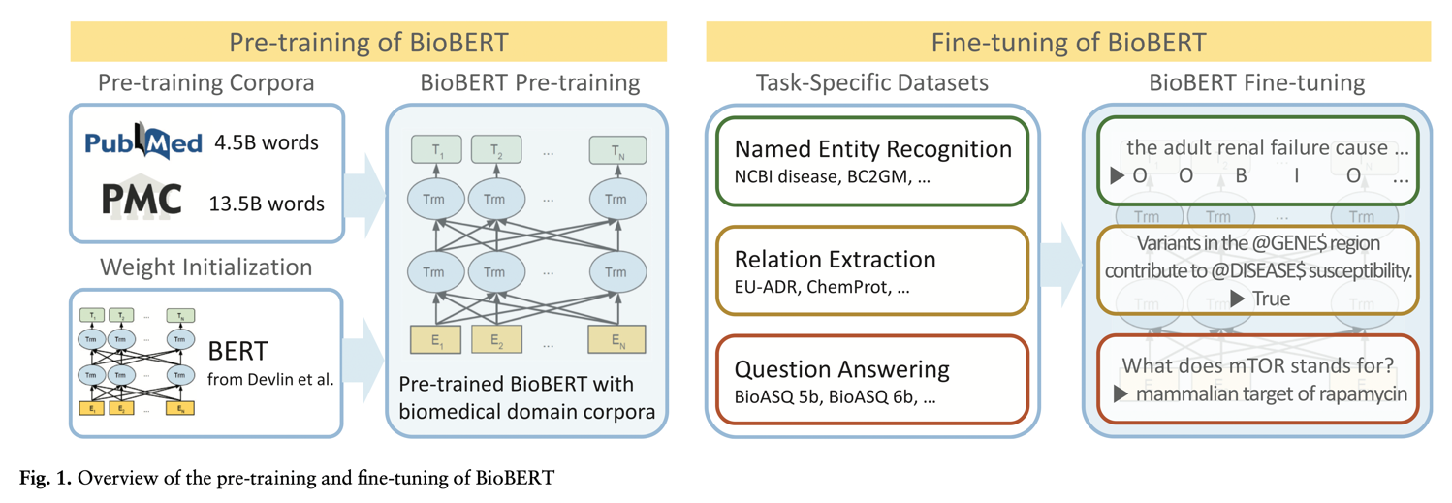
Pre-training on biomedical corpora is becoming less important with current LLMs.
Lee J, Yoon W, Kim S, Kim D, Kim S, So CH, Kang J. BioBERT: a pre-trained biomedical language representation model for biomedical text mining. Bioinformatics. 2020 Feb 15;36(4):1234-40.
Notes:
Lots of libraries out there for this
Huggingface

Slide 50
Pre-training on biomedical corpora is becoming less important with current LLMs.
Common LLMs (e.g. BERT, GPT4) have millions or billions of parameters (up to 1T)
However, the principles remain the same: neural networks performing hierarchical feature extraction
Different tasks require slightly different final modifications to the architecture
Deep NLP is becoming more accessible (and common in the clinical literature) as tools to acquire and use these models continue to improve

Slide 51
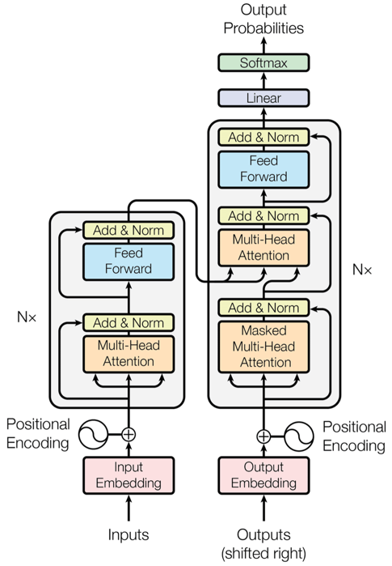
A Brief Tour of LLM Terminology
Encoder, Decoder
Autoregressive
Multi-head attention
Masked or next token prediction
Vaswani, Ashish, et al. "Attention is all you need." Advances in neural information processing systems 30 (2017).

Slide 52
How to build a large language model (LLM)
Step 0: invent word embeddings, transformer architecture, and other building blocks
Step 1: train to predict the next/missing word or sentence across a huge collection of documents
Generalist models: Wikipedia, common crawl, twitter (i.e., the internet)
Biomedical models: PubMed, MIMIC notes
Step 2: refine and align the models by having humans rate their outputs (i.e., reinforcement learning from human feedback)
Many variations on this, some of them closely kept
Possible role of critic models and learning to defer

Slide 53
Conclusions**
Text data are central to clinical medicine, so the potential for NLP impact is high (but not yet realized)
Simple, count-based NLP models are surprisingly effective in most clinical applications.
Complex, deep learning NLP models have exceeded human performance. In these models, words are converted to vectors of semantic attributes, and increasingly complex, heirarchical semantic features are then extracted.
Similar to image processing, we can take advantage of complex NLP models by repurposing them for a specific clinical task via fine-tuning of parameters.
Notes:
In summary…
Bag of words models solve this challenge by constructing a feature vector in which each element corresponds to a distinct word of interest, and its value is determined by counting the occorrences of that word in the document (or message, or passage)

